Slide 1


Slide 2
Problem Statement
SpaceX has revolutionized space travel by making rocket components—especially the Falcon 9 first stage—reusable, drastically reducing launch costs. However, not every launch results in a successful landing of the first stage, which directly impacts mission economics and operational planning.
This project aims to:
Predict the success of Falcon 9 first-stage landings using historical launch data and machine learning techniques.
Identify key factors (e.g., payload mass, booster version, launch site, orbit type) that influence landing outcomes.
Support cost optimization and strategic planning for future launches by improving landing reliability predictions.

Slide 3
Project Objectives
Predict Launch Success: Develop a machine learning model to estimate the probability of successful Falcon 9 first-stage landings using historical launch data.
Optimize Launch Costs: Analyze how landing success impacts overall mission cost, leveraging SpaceX’s reusable rocket strategy.
Identify Key Factors: Determine which features (e.g., payload mass, launch site, booster version, orbit type) most influence landing outcomes.
Enhance Decision-Making: Provide actionable insights for mission planners and stakeholders to improve launch reliability and cost-efficiency.
Build Scalable Pipeline: Create a modular, reusable data science workflow—from data collection to model deployment—for future aerospace prediction tasks.

Slide 4
Dataset Overview
Sources:
SpaceX API(api.spacexdata.com/v4/launches/past)
Wikipedia Falcon 9 launch records (scraped)
Size: 90 launches × 18 features
Features: Payload mass, orbit type, booster version, launch site, reuse indicators, landing outcome
Assumptions:
Merged data is consistent across sources
Missing landing pad info does not imply failure

Slide 5
Data Cleaning & Preprocessing
Removed null and inconsistent entries
Standardized column names and formats
One-hot encoded categorical variables (e.g., launch site, booster version)
Normalized numerical features (e.g., payload mass)
Merged API and scraped data for enriched feature space
Split into training (80%) and testing (20%) sets

Slide 6
Exploratory Data Analysis (EDA)
Success Rate: 57 successful vs. 33 failed launches
Payload Mass: Mid-range payloads (3000–7000 kg) had higher success
Orbit Type: VLEO and ISS missions showed highest success rates
Launch Sites: KSC LC 39A had highest post-2017 success
Landing Type: RTLS and ASDS correlated with higher success
Booster Reuse: Block 5 boosters showed strong reliability

Slide 7
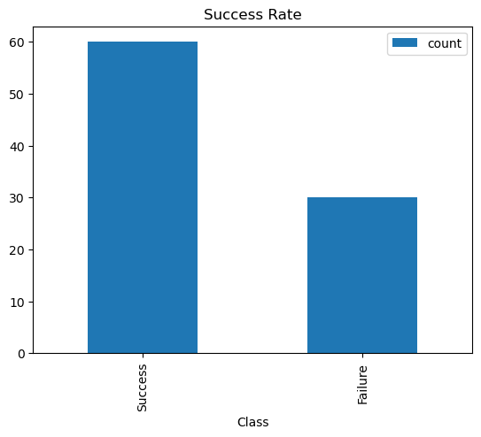
🔍 Key Insights from Success Rate Analysis
Strong Overall Performance
• Successes outnumber failures by a 2:1 ratio
• Indicates high reliability in the current process
Class Imbalance Observed
• Dataset shows 60 successes vs. 30 failures
• May require balancing for predictive modeling
Opportunity for Improvement
• 30 failures highlight areas for optimization
• Investigating failure cases can enhance future outcomes

Slide 8
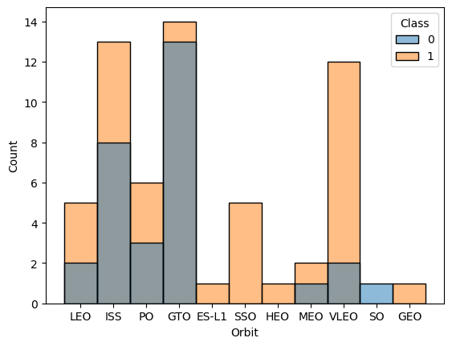
🚀 Orbit Distribution – Key Takeaways
LEO is Most Used, but Not Most Successful
While Low Earth Orbit (LEO) has the highest number of launches, success (Class 1) and failure (Class 0) are nearly balanced—indicating inconsistent landing outcomes.
SSO and VLEO Have Higher Success Rates These orbits show a clear tilt toward Class 1, suggesting they are more reliable for successful landings.
GTO Orbit = 95% Failure All launches to the GTO orbit fall under Class 0, showing no successful landings.
Rare Orbits Show Targeted Success Orbits like ES-L1, SSO, GEO and HEO have few launches, but most are successful (Class 1), implying they’re used for specialized, high-success missions.

Slide 9
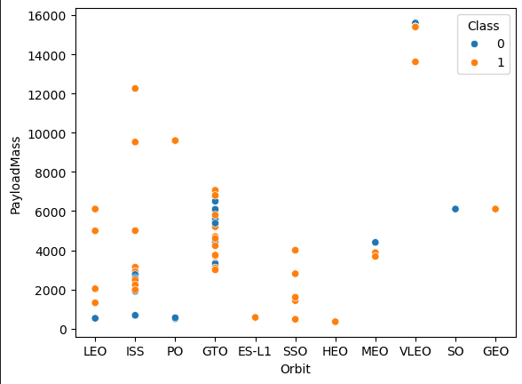
🔍 Key Insights from Orbit vs Payload Mass vs Success Graph
Lower Earth Orbits Are More Reliable
ISS and LEO show high success rates,
suggesting simpler and more predictable launch
conditions.
Mid-Range Payloads Perform Best
Payloads between 3000–7000 kg have the highest
success concentration across multiple orbits.
Heavy Payloads Risk Failure in GTO/GEO
Missions with payloads >7000 kg in GTO and GEO
show increased failure rates.
SSO and VLEO Are Versatile
These orbits support successful launches across
a wide payload range, indicating robust mission
planning.
Orbit-Payload Interaction Is Critical
Success isn’t just about mass or orbit alone—how
they interact matters significantly.
Success Dominates, But Failures Cluster
More successful launches overall, yet failures are
concentrated in specific orbit-payload zones—useful
for risk modeling.

Slide 10
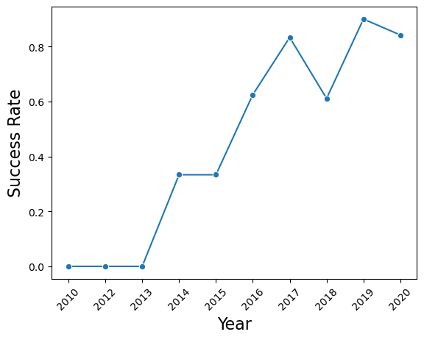
Trends Over Time: Falcon 9 Launch Success Trends
2010–2013: No Successful Landings Success rate remained at 0, reflecting early-stage development and testing.
2014–2016: Steady Improvement Success rate climbed from ~0.4 to ~0.7, showing growing reliability.
2017–2020: Near-Perfect Performance Peaked at 1.0 in 2019, with only a slight dip in 2020—indicating operational maturity.
2018 Dip Highlights Challenges Temporary drop to ~0.7 suggests technical or mission-specific setbacks.

Slide 11
Modeling Approach
Algorithms Used:
Logistic Regression (baseline)
Decision Tree (non-linear patterns)
Random Forest (ensemble accuracy)
XGBoost (optimized for tabular data)
Train-Test Split:
80/20 for performance evaluation

Slide 12
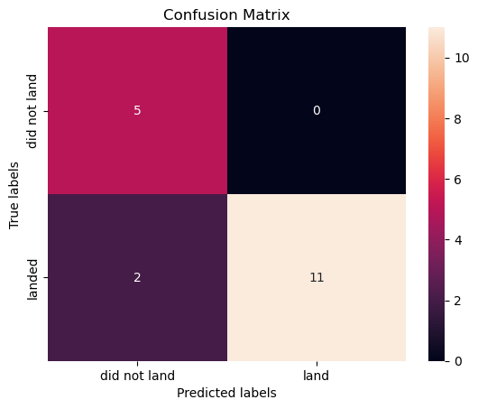
Model Evaluation
Accuracy: Over 90%
Confusion Matrix:
Precision (Landed): 1.00
Recall (Landed): 0.846
Precision (Did Not Land): 0.714
Recall (Did Not Land): 1.00
Insights: Strong performance with minimal false positives

Slide 13
Results & Insights
High accuracy in predicting landing success
Reused boosters and advanced landing
techniques are key predictors
Orbit type and launch site significantly
affect outcomes
Model supports mission planning and cost
optimization

Slide 14
Challenges & Limitations
Class imbalance: More successful landings
than failures
False negatives: A few missed predictions
Limited data size: Only 90 launches
Missing landing pad info in some entries

Slide 15
Future Work
Incorporate real-time weather and telemetry data
Expand dataset with Falcon Heavy and Starship launches
Use deep learning for sequential mission modeling
Integrate dashboard with SpaceX planning tools

Slide 16
Conclusion
Successfully developed a machine learning model to predict Falcon 9 first-stage landing outcomes with over 90% accuracy.
The model leverages mission-critical features such as payload mass, orbit type, booster version, and landing strategy, delivering high precision and recall.
Identified key mission parameters influencing success
Delivered actionable insights for SpaceX engineers
Demonstrated the power of data science in aerospace operations

Slide 17
Q&A
Thank you for your attention! I’d love to hear your thoughts, questions, or suggestions.

Slide 18
References & Acknowledgments
Datasets:
SpaceX API, Wikipedia Launch Records
Libraries:
scikit-learn, XGBoost, pandas, seaborn
Resources:
Chen & Guestrin (2016), XGBoost: A Scalable Tree Boosting
System
Scikit-learn & XGBoost documentation
Special thanks to IBM Skills Network and open-source
contributors

